Slide 1

REVIEW OF ECONOMIC PLANNING IN INDIA
By-:
Mohammad Aamir
2015UCP1541
Shubham Chourey
2015UCP1481

Slide 2

CONTENTS
INTRODUCTION
FIVE YEAR PLANS IN INDIA
OBJECTIVES OF PLANNING COMMISSION
ACHEIVMENTS OF PLANNING
FAILURES OF PLANNING
REASONS OF FAILURES
SOME SUGGESTIONS

Slide 3
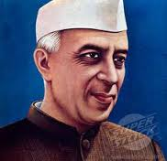
INTRODUCTION
After the independence, Indians leaders had the challenges to resurge the Indian economy.
The “Planning Commission” was an institution in Government of India , which formulated Five-Year Plans among other functions.
Formed on : 15 March 1950
Chairman : Mr. Jawahar Lal Nehru ( at the time of formulation )
Chairman for this institution would be the Prime-Minister of India .

Slide 4
Five Year Plans in lndia
Five Year Plans in lndia
The Planning Commission frames centralized and integrated national economic programs at the interval of every FIVE YEARS , thereby known as “THE FIVE YEAR PLANS”.
Till now 11 Five Year plans have been completed and 12th is in progress.
1)First Five Year Plan(1951-1956) 7) Seventh Five Year Plan(1985-1990)
2) Second Five Year Plan(1956-1961) 8) Eighth Five Year Plan(1992-1997)
3) Third Five Year Plan(1961-1966) 9) Ninth Five Year Plan(1997-2002)
4) Fourth Five Year Plan(1969-1974) 10) Tenth Five Year Plan(2002-2007)
5) Fifth Five Year Plan(1974-1979) 11) Eleventh Five Year Plan(2007-2012)
6) Sixth Five Year Plan(1980-1985) 12) Twelfth Five Year Plan(2012-2017)
There were economic holidays from 1966-1969 , 1978-1980 , 1990 -1992 due to some uncertainty in economy. E.g. inflation ,wars , lack of resources , etc.

Slide 5

Objectives of Planning Commission
Promoting development in various economic sectors.
Securing an increase in National Income.
Increase in employment.
Modernisation of the economy.
Accelerating the planned rate of investment.
To make necessary guidelines for better implementation of Five-Year plans.

Slide 6

Achievements of Planning
1. National Income & Per Capita Income
The average annual increase in national income registered-:
1901 to 1947 -> 1.2 %.
1950 to 2000-01 -> 3 %.
Recently -> 5.8 % .
Per Capita Income rise registered-:
First Plan -> 1.8 %
Second Plan -> 2.0%
Fifth Plan -> 2.7 %
Sixth Plan -> 3.2 %
Seventh Plan -> 3.6 %
Eighth Plan -> 4.6 %
2000-01 -> 4.9 %
In 2013-14 -> 5.3 %.

Slide 7
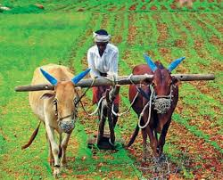
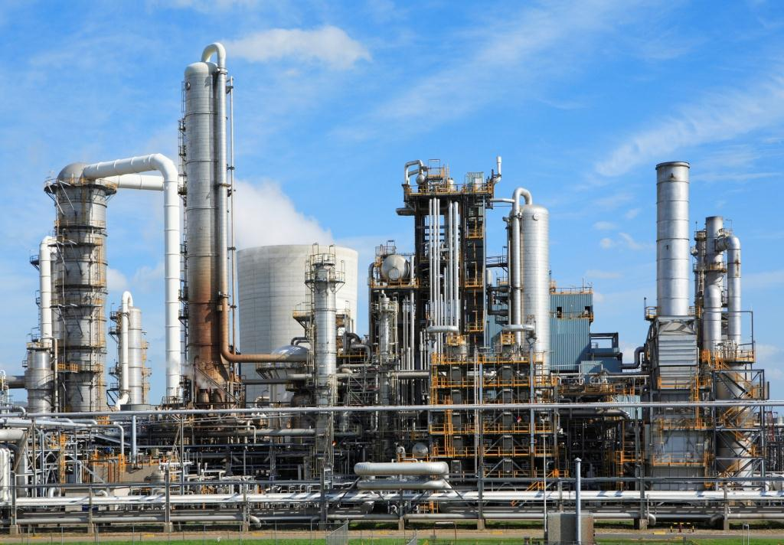
2. Development of Various Sectors of Economy :
Agriculture:
The production of food grains-:
1950-51 -> 510 lac tonnes.
1990-91 -> 1804 lac tonnes.
2000 -01 -> 212 million tonnes.
Currently -> 251.12 million tonnes.
During the entire planning period, growth rate of agricultural production remained 2.8 per cent per annum.
Green Revolution
Industry:
The production of finished steel-:
1950-51 -> 10 lakh tonnes.
2001-02 -> 31.1 million tonnes.
The production of coal and cotton clothes also increased manifold times.

Slide 8
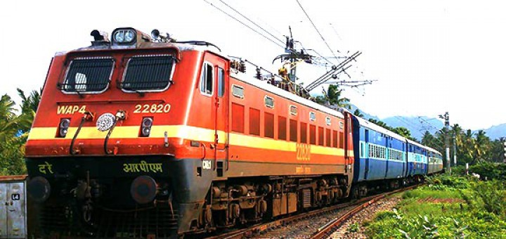

2. Development of Various Sectors of Economy :
Transport and communications:
Indian road-network is world's 2nd largest network.
4.2 million km of total length of roads.
Indian Railway network is one of the world's largest rail-networks.
Many plans were made to connect every village by telephone lines by November 2007.
Currently 101 million people in india using mobile phones.

Slide 9

3. Employment , Education and Literacy :
Employment Provided-:
First five year -> 70 lakh people.
Fourth and Fifth plans -> 370 lakh persons.
Seventh five year plan -> 340 lakh people.
“National Rural Employment Guarentee Act – 2005 “ was a big step towards this and it also benifitted a great number of families.

Slide 10
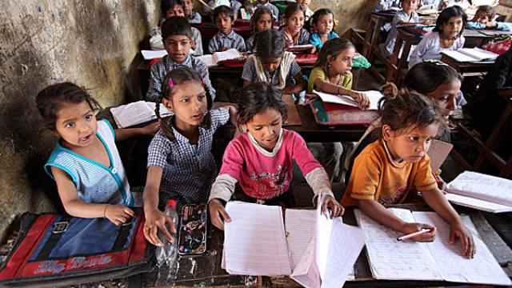
3. Employment , Education and Literacy :
Education and literacy :
Growth Rate-:
1950 -> 12%
2011 -> 74.04%.
From 2001 to 2011 the increase in literacy growth rate is 9.2%. highest growth rate is in Kerela (93.9%).
Seventh Five year plan improved facilities for girls education.

Slide 11
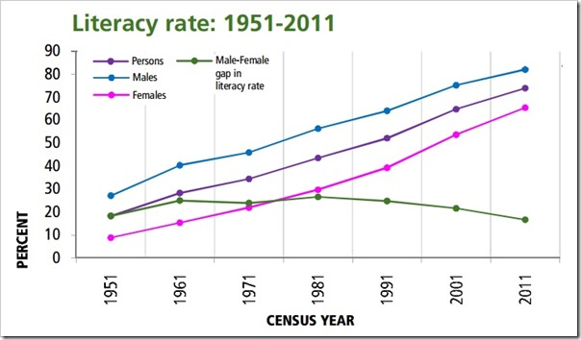
Source-: censusindia.gov.in

Slide 12

4. Self-Reliance
Progress have been made towards the achievement of self reliance.
We are no longer much dependent on other countries for the supply of food-grains and a number of agricultural crops.
Substantial investment is made in basic and heavy industries

Slide 13
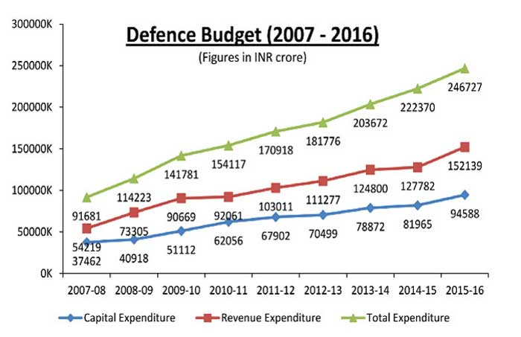
Source-www.indiandefencereview.com

Slide 14
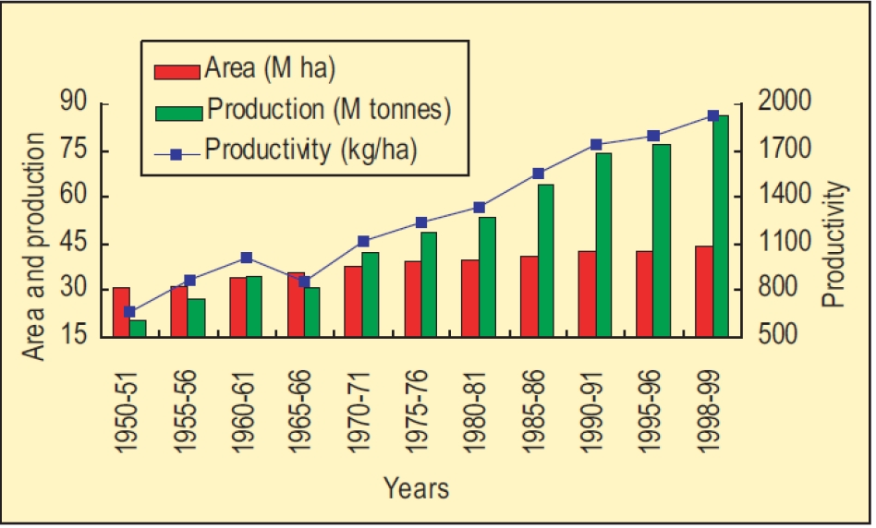
Source-: patriotsforum.org

Slide 15

5. Science and Technology
India stands third in the world in the sphere of science and technology.
Major achievements:
•Mangalyan Mission : launched on 5 November 2013 by ISRO in leadership of K. Radhakrishanan and his team.
•Chandrayan-1 : launched on 18 November 2008 under guidance of Mylaswami

Slide 16

6. Social Justice
The planning in India has an objective of sustained growth with social justice.
Plans ensures-:
the improvement of living standards of the people
removal of poverty
creation of additional jobs
reduction in inequalities of income and wealth.

Slide 17

7. Human Development Index
India climbed five notches to the 130th rank in the latest UNDP report.
India's HDI value for 2014 is 0.609, which puts the country in the medium human development category.

Slide 18
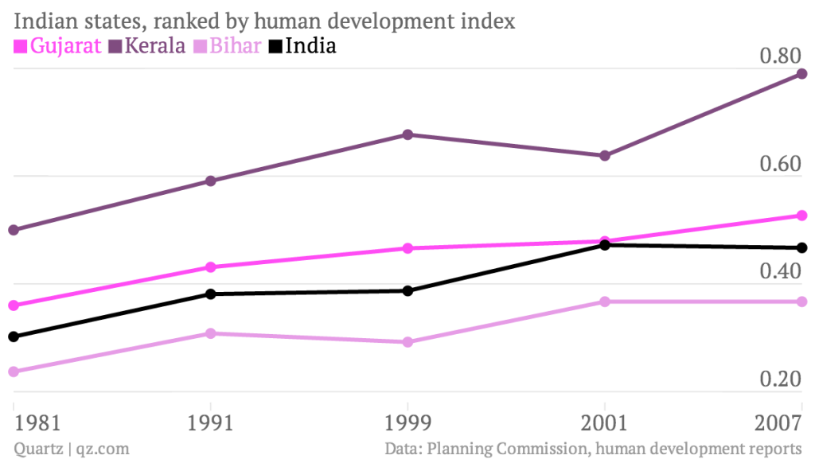

Slide 19
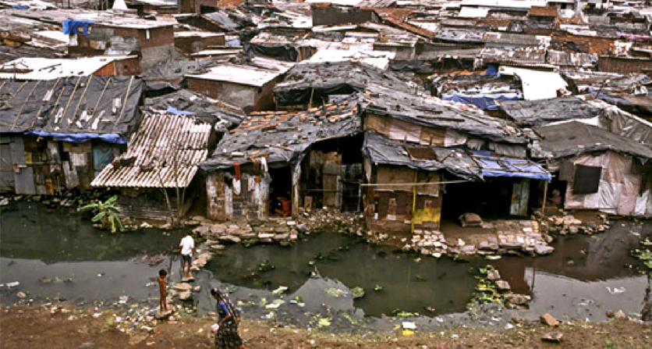
Failures of Planning
1. Many still under poverty line:
(a). Even after 60 years of establishment of planning commission ,India holds first position in possession of world’s poorest population.
(b). In 2015, 170 million people or 12.4 % of population lived under poverty line(1.9$ / day).

Slide 20
2.Agricultural growth rate
In 1956 (After 1st five year plan):
Population: 30 billion
Target agricultural growth rate: 2.1%
Achieved : 3.6%
More than enough.
In 2016:
Population: 122 billion
Growth rate should at least be 4 % so it can be accelerated to 7% in upcoming 2 years.
We had a growth of less than 1.5%
Less than sufficient
A threat to food supply for overly increasing population

Slide 21

3.Mounting unemployment:
Percentage of labor force without jobs is unemployment rate.
According to CIA world fact book in 2013 unemployment rate of India was 8.8% , which is quite high given the large indian population.
4.Imbalanced regional growth:
No balanced regional growth.
Literacy rate in Kerala is 93.91% while in Bihar it is only 63.82%.
According to annual report of RBI, 2013:
39.9% population of chhattisgarh is poor, while in Tamilnadu it is 11.28

Slide 22

5. Concentration of wealth:
Despite having the highest percentage of world’s poorest population:
India holds 4th position in most number of billionaires after the USA, China and germany .
1% of the population has nearly 60% of its wealth, a major chunk of population is still deprived.
Source: www.forbes.com
Global wealth report by credit suisse research institute.

Slide 23
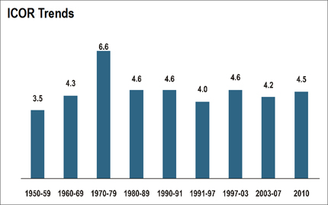
6. High incremental capital output ratio:
This is the ratio of capital used to output produced over a period of time.
According to statistics this ratio is increasing.
Reflects inefficient use of resources.
Source: central statistical organization

Slide 24
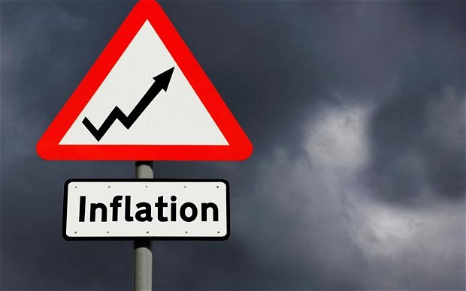
7.Inflationary pressure:
Price stability- one of the objectives all plans.
Was hardly achieved.
Inflation may be helpful for developed countries but not for developing ones like India. ****
8.Adverse balance of payments:
BOP of India is accelerating towards negative axis
Imports increasing faster as compared to exports.
India is hardly a manufacturer.

Slide 25
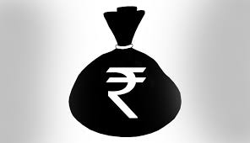
10.Low living standards:
Human development index
India ranks 131 among all countries in HDI according to the UNDP report given in 2015.
Happy planet index (HPI)
We were at 50th position among all countries analyzed in HPI.
10.Black money:
Is India really poor:
In early 2011, there were reports of Swiss Bankers Association officials to have said that the largest depositors of illegal foreign money in Switzerland are Indians.
Deposited money was 13 times larger than the national debt.
One really needs to rethink if india is poor country.

Slide 26

What are the reasons behind these failures?
What are the necessary plans to be adopted?

Slide 27
Too ambitious plans
Plans have had very ambitious objectives.
The fact that in most cases objectives have not been realized points it out.
Neglect of agriculture:
In growth objectives a greater attention for long has been devoted to capital goods industries rather than to covering consumer goods.
Agriculture is the most important as it produces largely consumer goods and raw materials for consumer goods industries.

Slide 28
Faulty implementation:
The level of implementation of plans projects particularly with respect to rural development agriculture and social welfare sector was poor.
The targets could not avail the benefits of plan projects in proper time.
Incompatibility and inconsistency of objectives:
The objectives when seen together are technically illogical.
For example, the emphasis on a rapid rise in capital stock does not go well with the objective of reducing inequalities.

Slide 29
Some other reasons are:
Lack of pragmatic approach.
Corrupt administration.
Lack of Co-ordination

Slide 30

Suggestions For Improving Planning
1. Consciousness for Planning
2. Initiative at Top Level
3. Proper Communication
4.Participation In Planning
5. Emphasis on Long term as well as Short term Planning

Slide 31
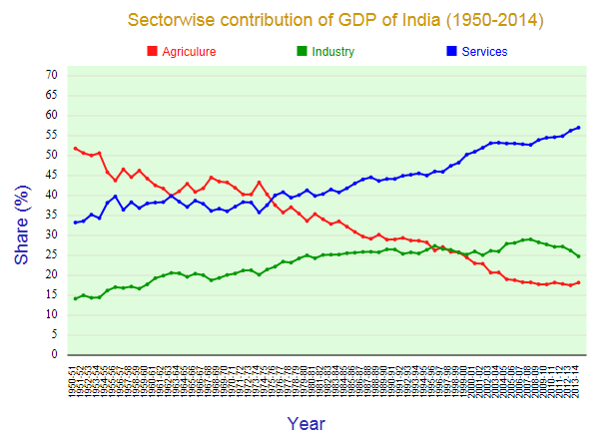
Source-: statisticstimes.com

Slide 32
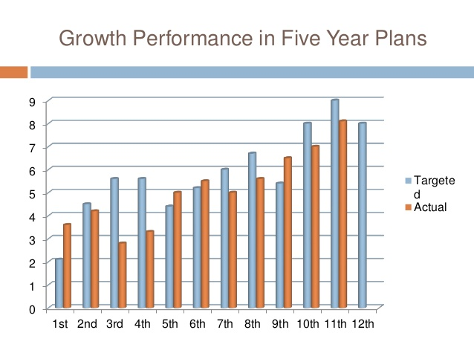
Source-: 12thplan.gov.in

Slide 33


